Slide 1
Neural Style Transfer

Slide 2
What’s neural style transfer
Neural style transfer is an optimization technique used to take two images, a content image and a style reference image such as an artwork by a famous painter, and blend them so the output image looks like the content image, but “painted” in the style of the style reference image. This technique is used by many popular Android iOS apps such as Prisma, DreamScope, and PicsArt.

Slide 3
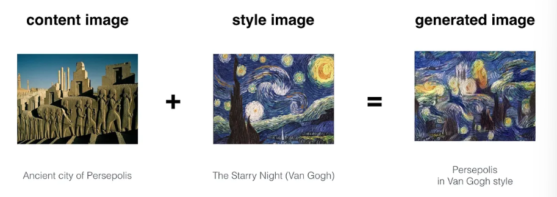
What’s neural style transfer

Slide 4
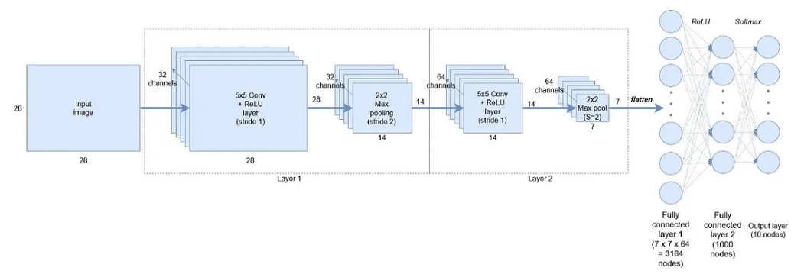
What’s Convolutional Neural Network

Slide 5
What’s Convolutional Neural Network
In CNNs, at Layer 1 with 32 filters, the network detects basic patterns like lines. As we move to Layer 2 with 64 filters, it identifies more complex features such as faces or wheels. This progression in feature detection is known as feature representation. CNNs encode images without understanding their content, making them useful for tasks like Neural Style Transfer

Slide 6
How Convolutional Neural Networks are used to capture Content and Style of images?
VGG19 network is used for Neural Style transfer. VGG-19 is a convolutional neural network that is trained on more than a million images from the ImageNet database. The network is 19 layers deep and trained on millions of images. Because of which it is able to detect high-level features in an image.Having the above intuition, let’s define our Content Loss and Style loss to randomly generated noisy image.

Slide 7
How Convolutional Neural Networks are used to capture Content and Style of images?
Now, this ‘encoding nature’ of CNN’s is the key in Neural Style Transfer. Firstly, we initialize a noisy image, which is going to be our output image(G). We then calculate how similar is this image to the content and style image at a particular layer in the network(VGG network). Since we want that our output image(G) should have the content of the content image(C) and style of style image(S) we calculate the loss of generated image(G) w.r.t to the respective content(C) and style(S) image.

Slide 8
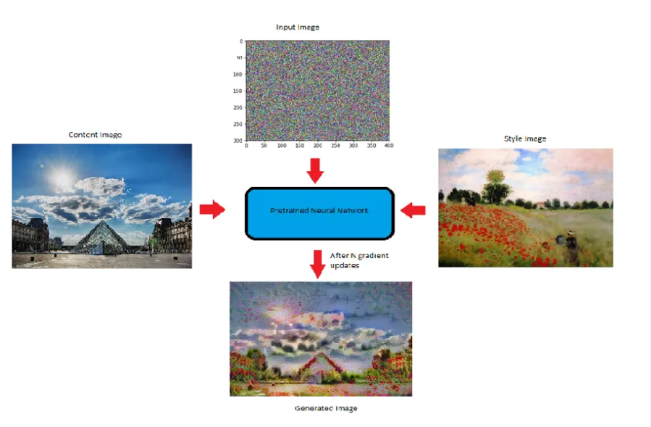
How Convolutional Neural Networks are used to capture Content and Style of images?

Slide 9
How we capture style of an image
Correlation refers to how similar or related two filters or channels are in capturing features within an image. For example, if two channels like Red and Yellow detect vertical lines and produce similar effects wherever such lines appear, they are considered correlated.To calculate this correlation mathematically, we compute the dot product of the activation vectors of the two filters. This computation results in a matrix known as the Gram Matrix.

Slide 10
How we capture style of an image
Determining correlation involves checking the size of the dot product: a large dot product indicates high correlation, meaning the channels capture similar features, while a small dot product signifies low correlation, indicating different features or patterns.

Slide 11
Steps To Create The Neural Style Transfer
Importing Libraries
Import Image data
Image processing
Model Initialization
Content Model defining
Style Model defining
Content Loss
Model Training
Model Prediction

Slide 12
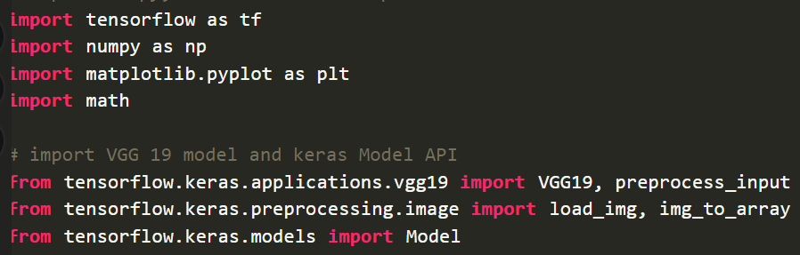
Importing libraries

Slide 13
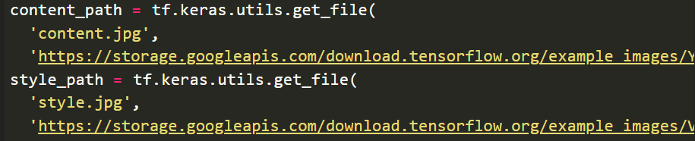
Import Image Data

Slide 14
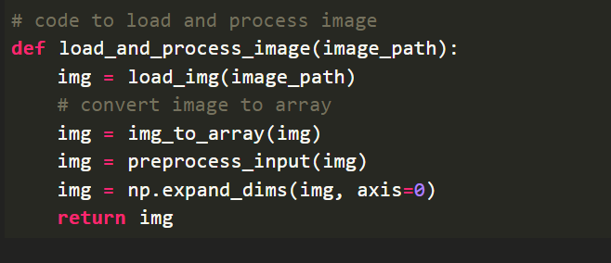
Image processing

Slide 15
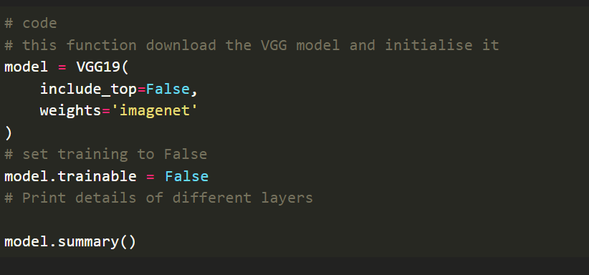
Model Initialization

Slide 16
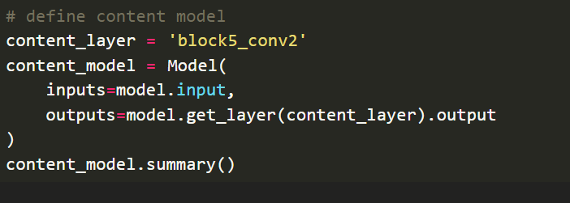
Content Model Defining

Slide 17
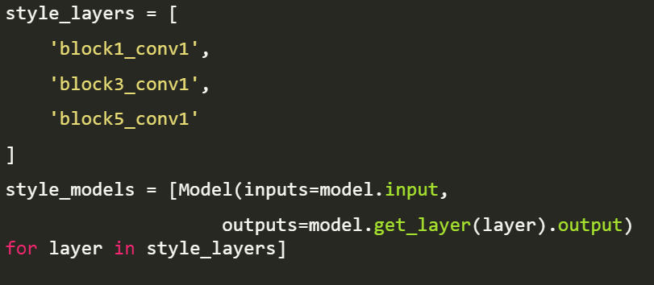
Style model defining

Slide 18
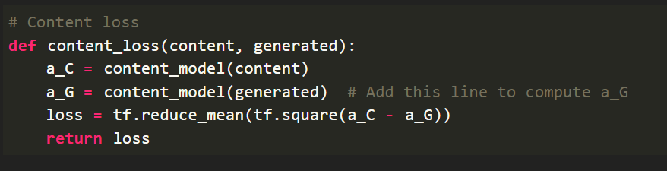
Content Loss

Slide 19
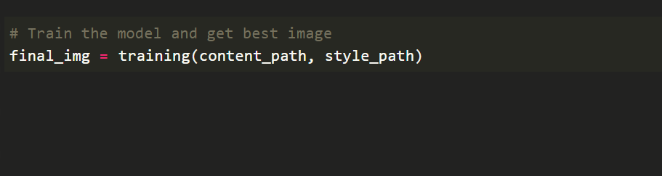
Model Training

Slide 20
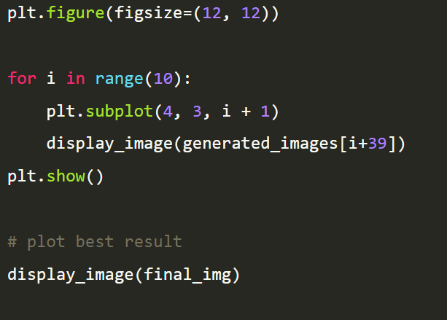
Model Prediction

Slide 21
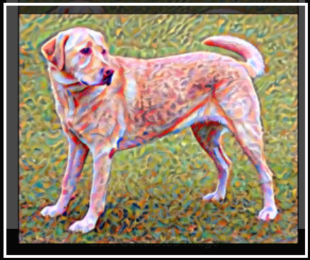
output

